Slide 1
USER TRAINING MANUAL
Stock Take Feature

Slide 2

Introduction
This feature will enable koko delivery personnel to conduct stock-take activities through the mobile/zebra devices and relay the results to the ERP system for easy viewing and decision making
This feature gives the dispatch supervisor flexibility to set mandatory shops which stock take must be taken during delivery trips or by default allows any shop in the trip to have stock taken as long as the user selects the action when prompted.
We have also made changes to the fulfillment logic to enable customers fulfill from any shop regardless of where the product was first delivered
Upon reaching the shop and selecting stock-take activity, the app will pull all the serials associated with that shop from the ERP and this data will be used as the reference point to determine the scan result. Stock-take activity will result into 3 outcomes;
Expected- The serials scanned in the shop are the one which should be there
Unexpected- The serials scanned in the shop shouldn't be in that particular shop but in another shop
Missing- There is a serial expected to be at the shop but it’s not there
Once this results are transmitted to the ERP, the relevant stakeholders will have access to view and initiate investigations to establish reasons for the missing products. The outcome will determine if we either scrap the item off the inventory catalogue or if missing item is found and taken to a shop for sale.

Slide 3
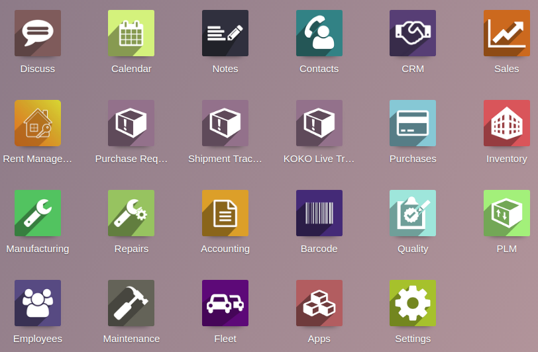
Setting the trip
The dispatch supervisor will create the delivery trip and choose which shop stock take task is mandatory.
Note: by default all shops in the trip will have an option of stock take however the ones whose checkbox are selected must have their stock taken first before any delivery is done.
click on the ‘Fleet’ Module on Odoo home page
click here
Once the shop details ope, group by ‘state’ to view shops in draft state and select the ones scheduled for delivery

Slide 4
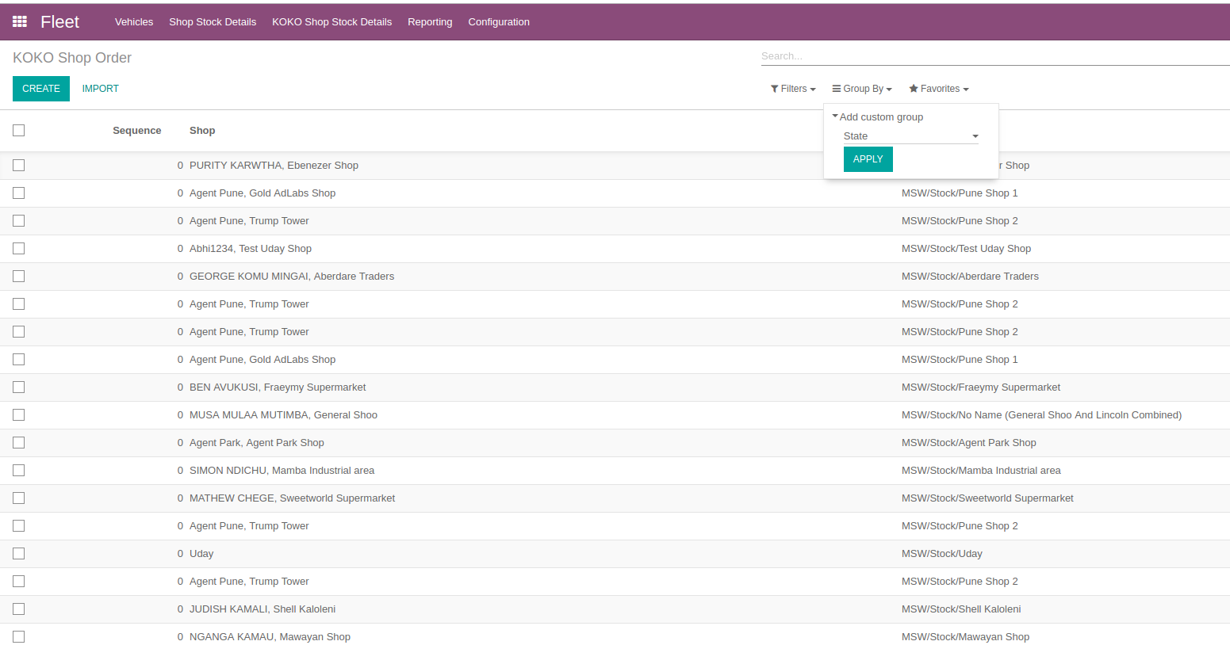
Notes:
Mercy, 0705501016, went to collect her cooker yesterday but found her account has no funds.
We had a unique transaction where a customer’s transactions are not showing on KOKO Core ie The customer bought fuel after fulfilment and one month into and this is not reflecting on KOKO core. (254725959317) .

Slide 5
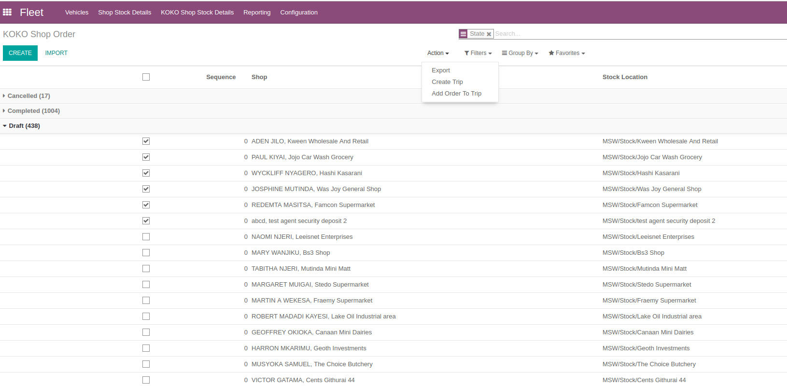
TRIP CREATION TRIP
Click to create trip

Slide 6
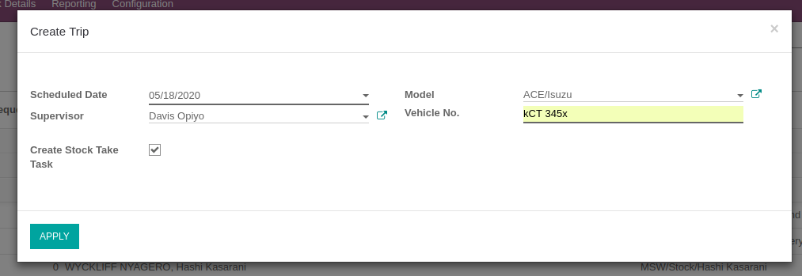
SETTING TRIP PARAMETERS
Select the date of the trip, vehicle, supervisor who will undertake the trip and the tick the checkbox if you intend for mandatory stock take to be done on these shop
Check the box to make stock take task in the selected shops mandatory
Click here to confirm the settings

Slide 7
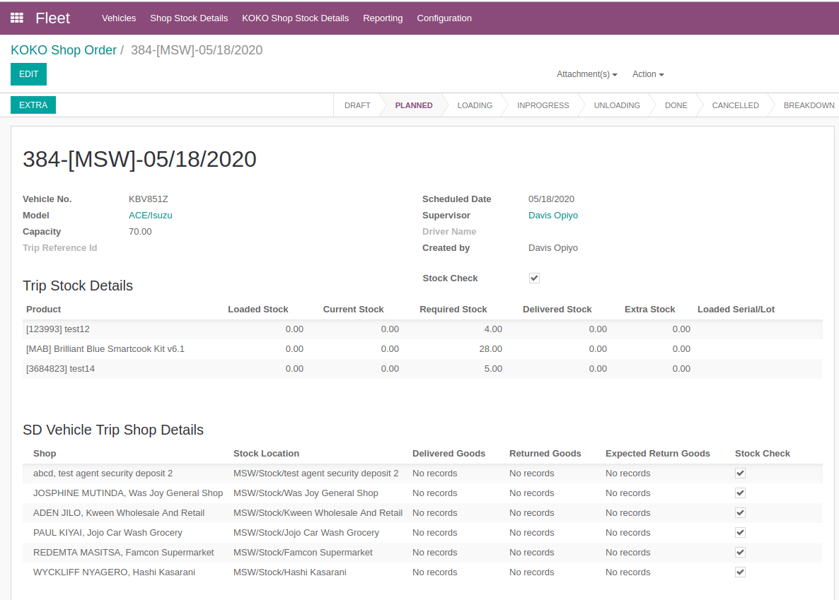
TRIP PAGE DETAILS
Once trips details are confirmed, the trip page will populate in ‘Planned’ state. This form is only editable at planned state. One can;
uncheck the checkbox to make the stock take activity optional for a shop
Tick the checkbox to ensure stock take must be done at that shop
change number of product to be delivered
Change the person ‘supervisor’ to undertake the trip
Change the trip date and vehicle number
User can check or uncheck the boxes

Slide 8
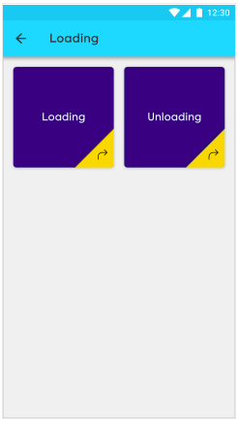
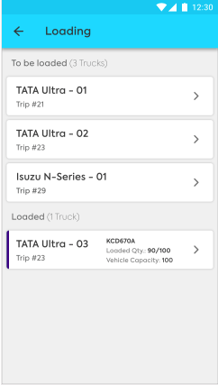
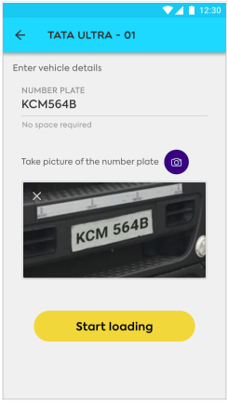
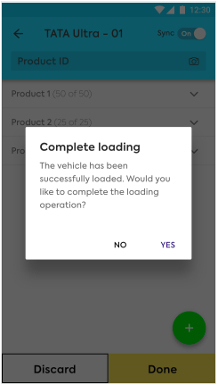
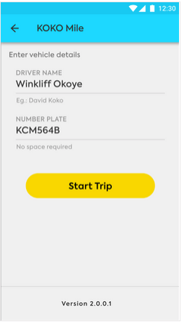
LOADING OF PRODUCTS & STARTING THE TRIP
Once the trip details have been confirmed, the delivery personnel will open the loading app, scan the items into the vehicle and start the trip
Click here to start loading
Select a trip assigned to you
Enter vehicle details,photo and click ‘Start loading’ to load items into the vehicle
Confirm loading completion
Start trip

Slide 9
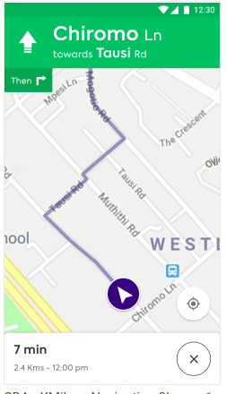
NAVIGATING TO SHOP
The delivery personnel will navigate to the shop and perform stock-take activity

Slide 10
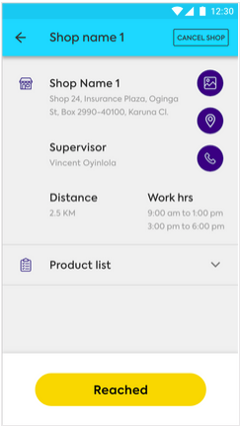
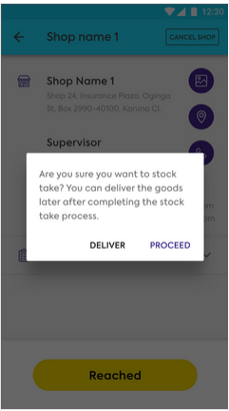
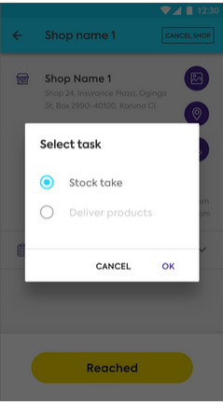
PERFORMING STOCK TAKE
If the shop’s stock-take box was checked during setting of the trip details, ‘stock take’ task is automatically selected
Click on ‘Proceed’ to undertake stock activity
The user clicks ‘Reached’ once he/she has arrived at the shop

Slide 11
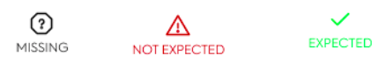
STOCK TAKE PROCESS
On clicking ‘Proceed’, the app pulls serial number associated with the shop from the ERP. This will be used as primary reference point during scan to provide the status of the products scanned.
Only the last two digits will be visible at the start but the numbers will fully populate once scanned. The stock-take activity will bring out 3 different status;
Expected- Products which the ERP indicates should be in the shop and are physically in the shop
Unexpected - Products which are physically in the shop but ERP indicates should be in another location
Missing - Products which ERP indicates should be in the shop but are physically not there.
When initially pulled from ERP, all serials will have the missing symbol. The symbols will change during scanning to reflect the validation results

Slide 12
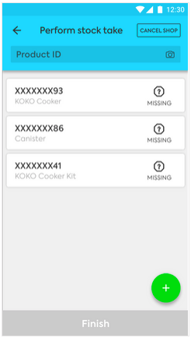
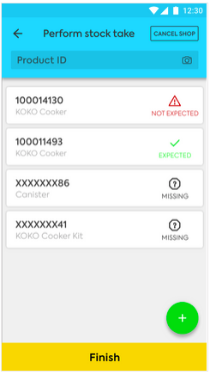
Symbols
Only last 2 digits are revealed
when serials are initially pulled from ERP, it will have ‘missing’ symbol but will gradually change as you scan the physical products

Slide 13
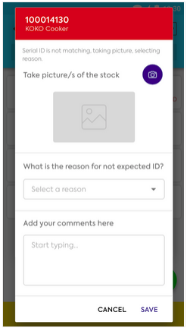
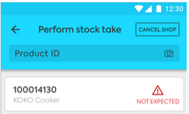
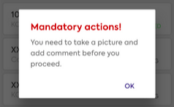
SYMBOL RULES
Overall, upon clicking the serial it will provide a form to take photos and state comments. However for ;
Unexpected serials it will make it mandatory to take photos and provide reasons
Missing serials it will make it mandatory to provide reason
The app wont allow user to scan next without providing photo and reason

Slide 14
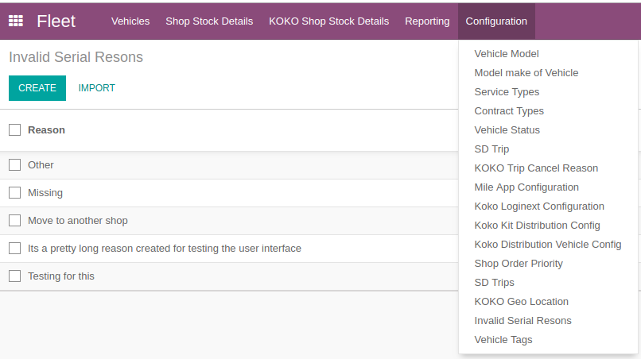
SETTING INVALID REASON
The reason to be selected on the app drop-down will be configured in the ERP. The user need to have ‘Stock take manager’ access right to be able to set or edit these reasons
Fleet > Configuration > Invalid Serial Reasons

Slide 15
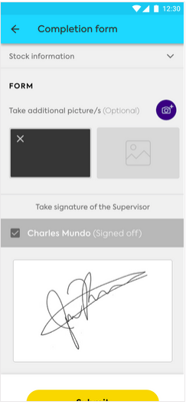
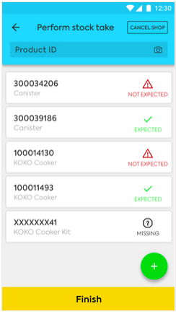
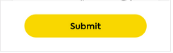
COMPLETION FORM
Once the user finishes scanning and providing reason / for missing or unexpected serials, he/she will click ‘Finish’ to access the completion form
The user will take any additional photo (optional) and request the agent to sign on the screen. If the agent is not available, the designated person’s name present at the shop will be recorded and he/she will sign off the activity. The user will click ‘Submit’ to finish the activity
Click here to access the completion page
Click here to submit

Slide 16
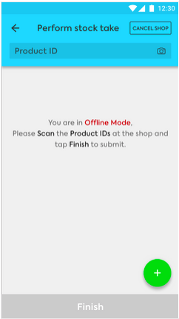
SCANNING IN OFFLINE MODE
If the user reaches shop destination and encounters poor internet reception which does not allow real-time syncing with the ERP, the app will allow the user to scan the items and submit for results.

Slide 17
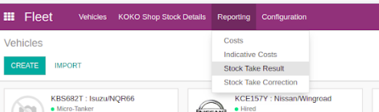
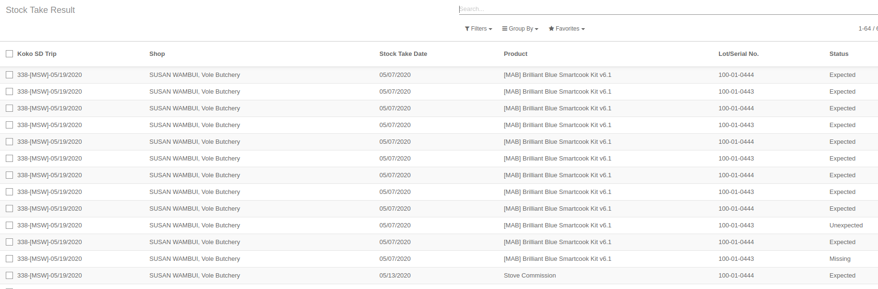
VIEWING OF RESULTS IN THE ERP
Once stock take is done, senior management will view the report in odoo for informed decision making.
Fleet > Reporting >Stock take results
Stock Take Result Page

Slide 18
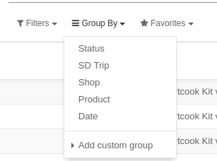
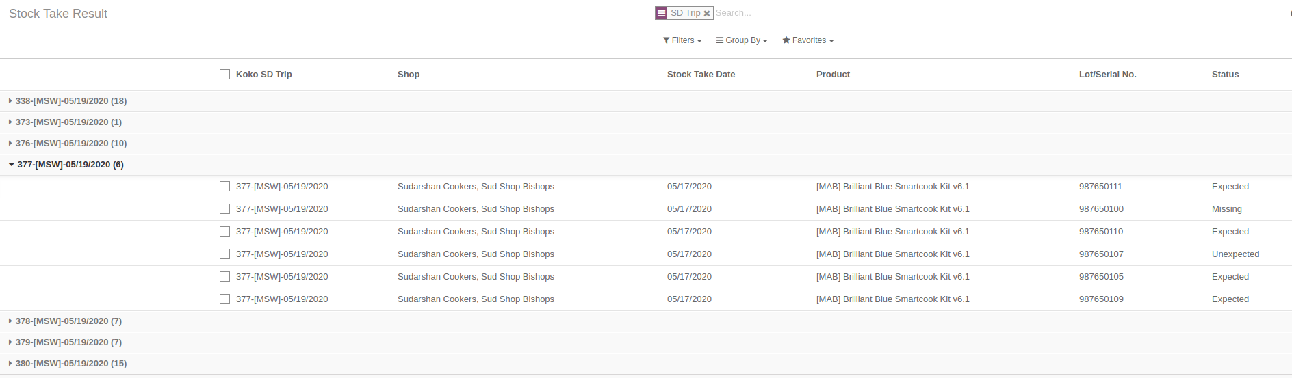
The user can apply filter to view results of multiple trips.
Group by > SD Trip
Click on the trip Id and view the results

Slide 19
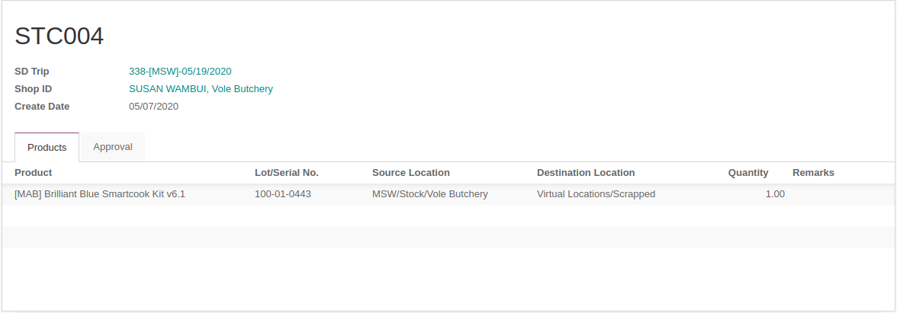
SCRAPPING OF MISSING PRODUCTS
Once investigations are complete and a product is determined to be lost, the warehouse manager will initiate the process of removing it from the ERP so as not to reflect in the active stock count.
However for this action to be fully effected, it must go through an approval matrix configured, it will need approval from the distribution manager and final approval from the General Manager

